Slide 1
Crimson Clubs (Design)
Adam Gabriel, Travis Redfield, Taylor Meads,
Maclane May, Max Livingston

Slide 2
Problem Description
None existent quality club and intramural calendar and statistical tracking
Poor existing applications/solutions
Hard to use
Slow
Poor user experience
Intrusive Advertisements

Slide 3
Scope of System
Manage clubs and teams
Receive push notifications to your phone
View calendar of events

Slide 4
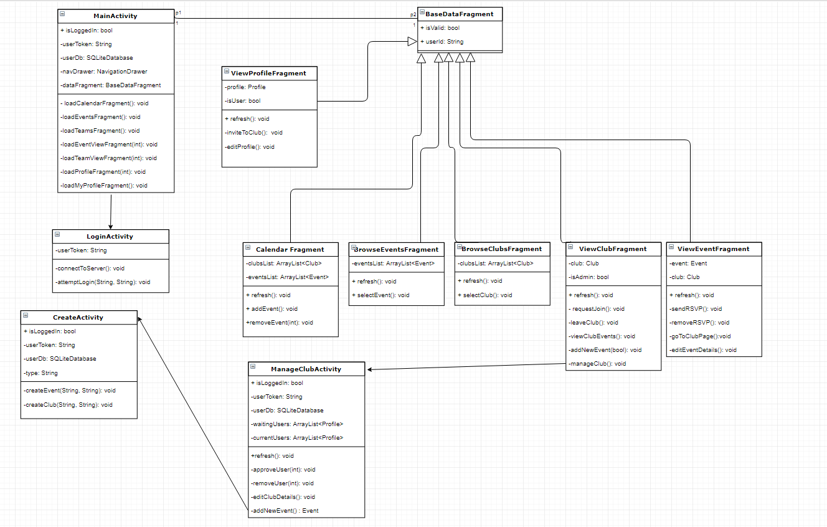
Class Diagram

Slide 5
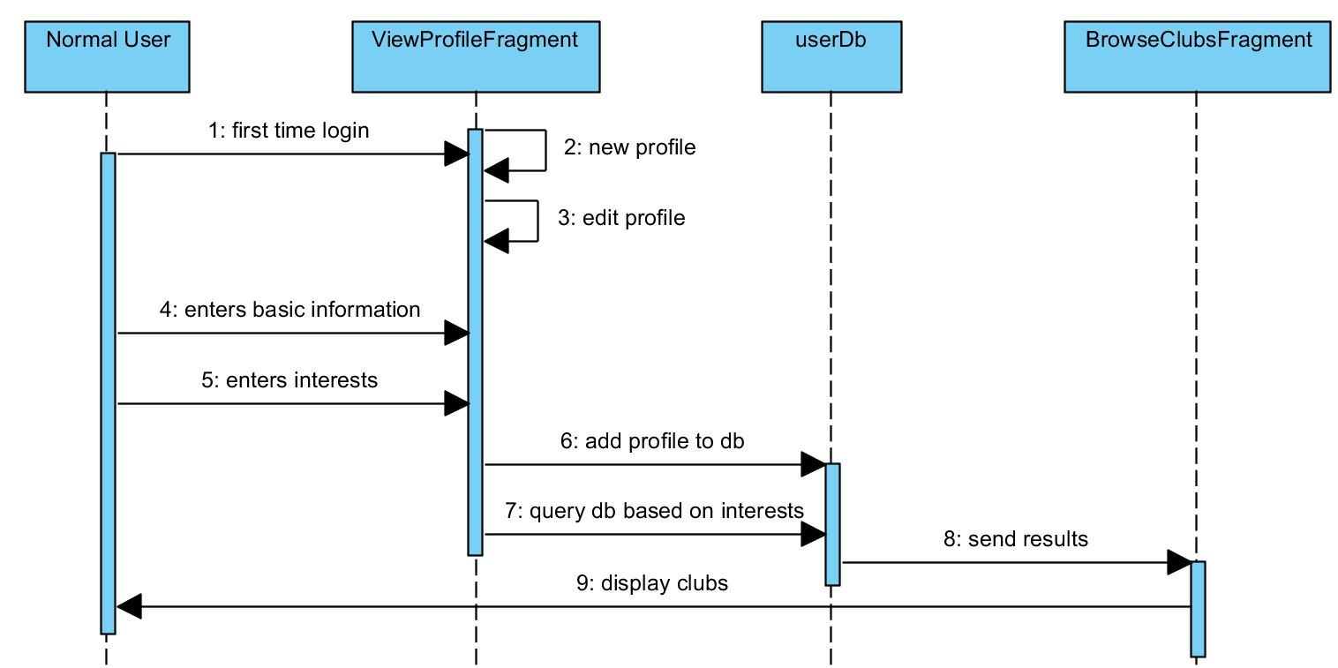
Create Profile

Slide 6
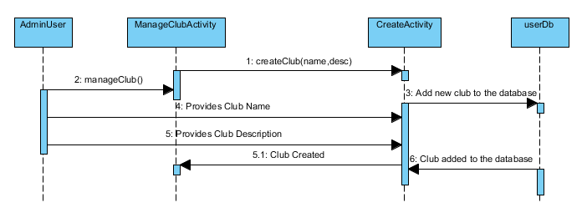
Create Club

Slide 7
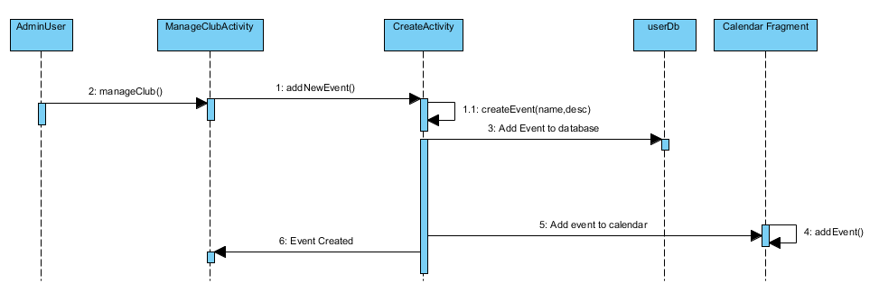
Create Event

Slide 8
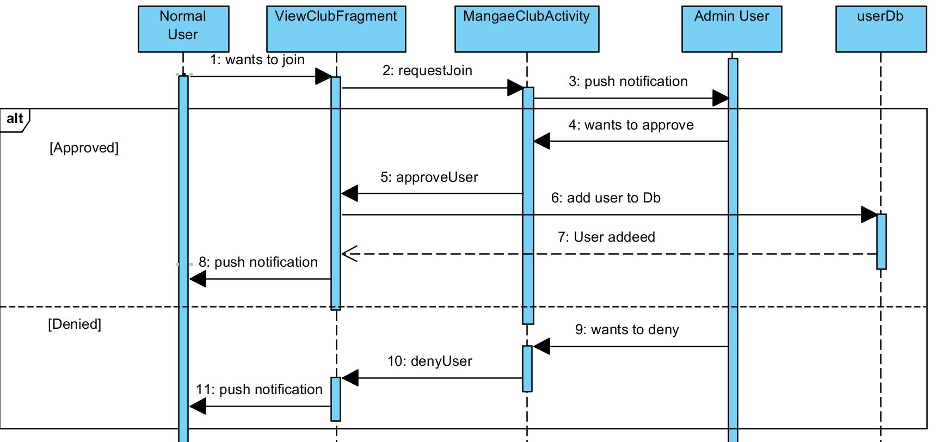
Join Club

Slide 9
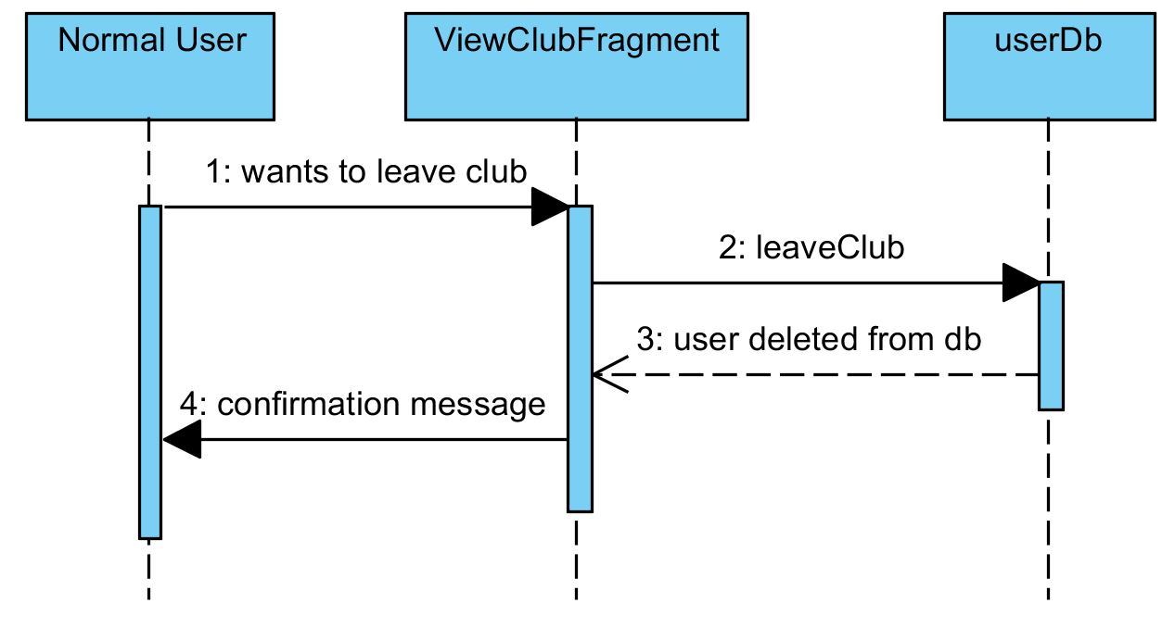
Leave Club

Slide 10
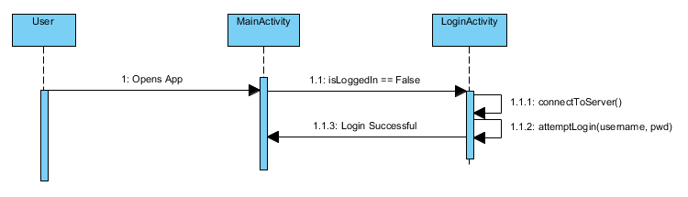
Login Activity

Slide 11
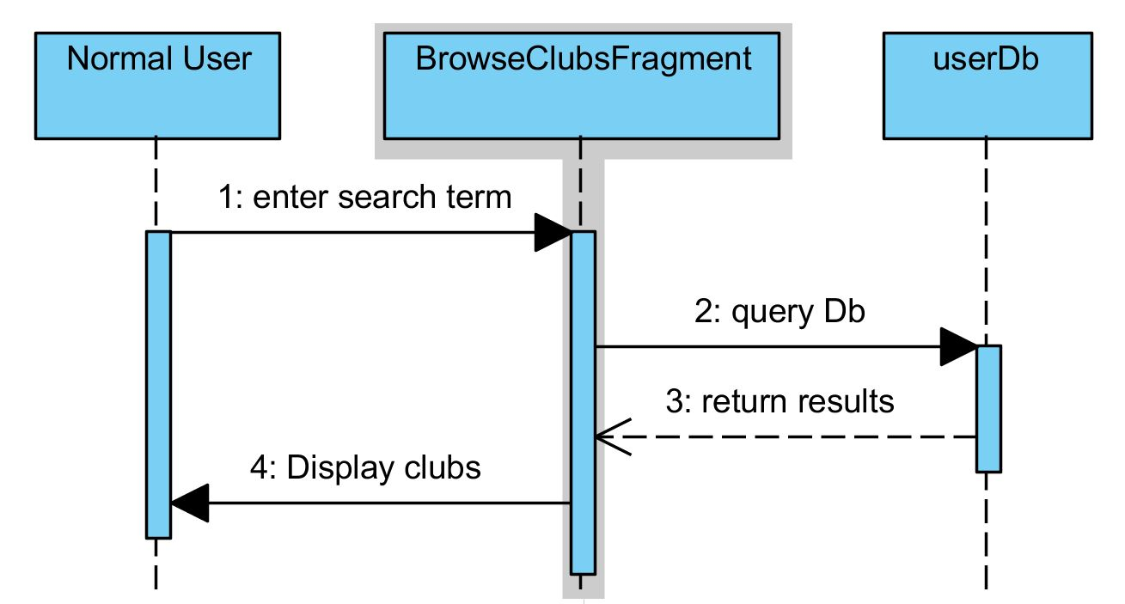
Search Clubs

Slide 12
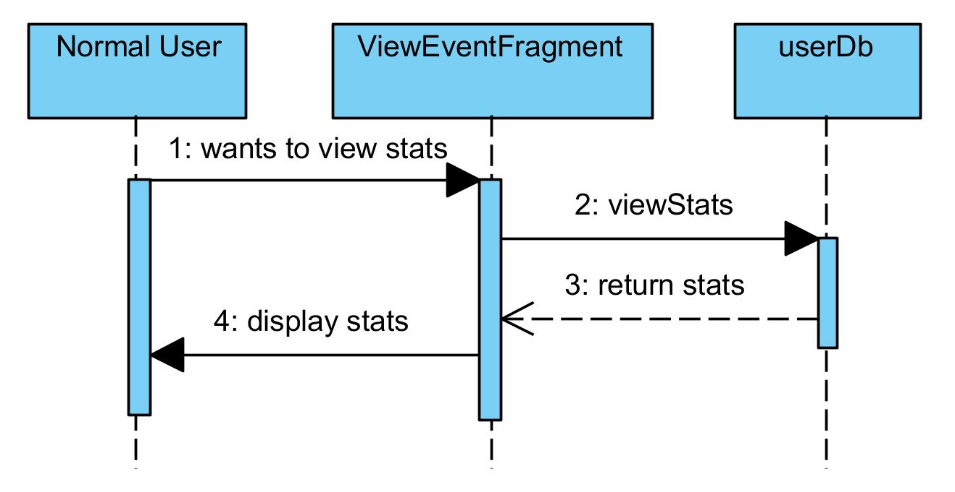
View Event Statistics

Slide 13
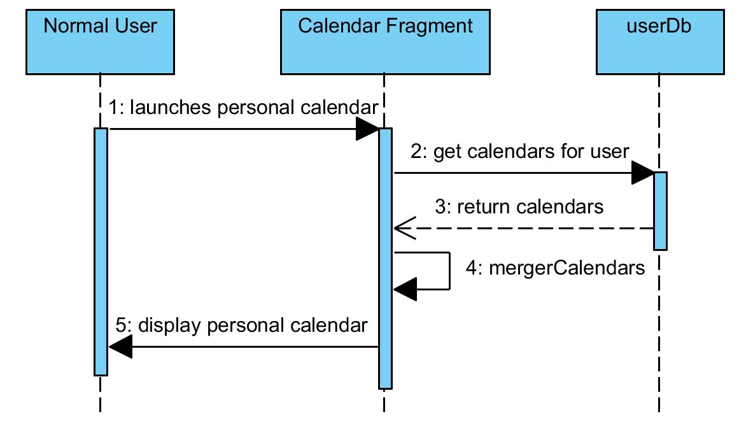
View Calendar

Slide 14
Project Changes
No major project changes
Shifting focus
Database
Stored procedures
Web calls
Front end

Slide 15
Summary
Good Progress
Everything is going has planned

